Slide 1
MACOM Diode Products rev 0
Joe Bukowski, Rick Cory
31 January 2017

Slide 2
PRODUCT FAMILIES
PIN/NIP Diodes:
Switching
Attenuation
Limiting
Varactor Diodes:
Tuning
Phase Shifting
Schottky Diodes:
Detection
Frequency Mixing
Diode Products
Attenuators
Multiplier Diodes:
Frequency Multiplication
Waveshaping
Passive Devices
RF Chokes/Inductors
MNS Capacitors
Resistors

Slide 3
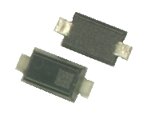





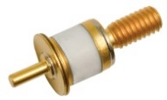




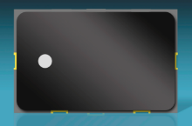
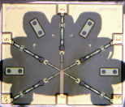
PRODUCT CONFIGURATIONS
Plastic
(to 6 GHz)
HMIC Discrete Surmount
(to 26.5GHz)
Bare Die
(to 18 GHz)
Discrete Device
MELF
(to 1 GHz)
Hermetic Packaged
(to 12 GHz)
Beam Lead/ Flip Chip
(to 70+ GHz)
HMIC, AlGaAs
(to 70+ GHz)
Integrated Solutions
Hybrid Solutions
Multichip Modules
(to 8 GHz)

Slide 4
PIN Diodes
Switching
Attenuation Receiver Protector Limiting

Slide 5
PIN Diodes
PIN Diodes used in switches typically have low capacitance and low series resistance
I layer thickness and thermal resistance determine RF power handling
PIN Diodes used in attenuators typically have
low capacitance for low insertion loss
thick I layers for large available range of resistance and low distortion
PIN Diodes used in limiters typically have low capacitance for low insertion loss
I layer thickness determines threshold level, recovery time and flat leakage

Slide 6
PIN Diodes
PIN Diodes are current-controlled RF resistors
Primarily used in control circuits
Switches
Attenuators
(Switched Transmission Line) Phase shifters
MACOM PIN diodes made from Si, GaAs or AlGaAs

Slide 7
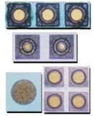
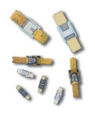

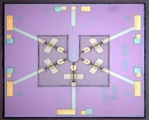
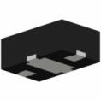
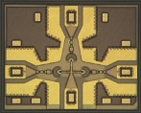

PIN Diode Families
Si Discrete | Si HMIC™ | GaAs | AlGaAs
Wide operating frequency range, to 20 GHz Excellent power handling PIN and NIP diodes available I layer: 2 – 300 µm Available as: Unpackaged chips SMT packages Ceramic Packages Beam leads | Very Wide operating frequency range, to 30 GHz I layer: 8 – 100 µm Available as Single junction devices Multiple junction ICs Wire-bondable or solderable | Wide operating frequency range, to 30 GHz Good power handling Available as: Unpackaged chips SMT packages Ceramic Packages Beam leads | Extremely Wide operating frequency range, to 100 GHz Lower insertion loss than comparable Si or GaAs switches I layer: 3 µm Available as Multiple junction ICs Wire-bondable

Slide 8
PIN Junction
Consists of heavily doped P and N layers separated by undoped Intrinsic layer
Anode
Cathode

Slide 9
PIN Doping
P layer is heavily doped with acceptor atoms (excess holes) to produce net positive charge
I layer has very light donor doping
N layer is heavily doped with donor atoms (excess electrons) to produce net negative charge
p
+++++++++++++++++++++++++++++++++++++++++++++++++++
- - - - - - - - - - - - - - - - - - - - - - - - - - -
pn
junction
i
- - - - - - - - - - - - - - - - - - - - - - - - - - - - - - - - - - - - - - - - - - - - - - - - - -
n

Slide 10
Depletion Region
Charge carriers are attracted to each other
At the junction they recombine to form depletion region which has zero net charge
p
+++++++++++++++++++++++++++++++++++++++++++++++++++
depletion region
- - - - - - - - - - - - - - - - - - - - - - - - - - -
i
- - - - - - - - - - - - - - - - - - - - - - - - - - - - - - - - - -
n

Slide 11
Current-Controlled Resistor
Depletion region has zero net charge, which makes it an insulator
P layer is very heavily doped, making it a conductor and source of holes
N layer is very heavily doped, making it a conductor and source of electrons
I layer is very lightly doped, which makes it a resistor with high resistivity

Slide 12
PIN Junction - Forward Bias
Under forward bias
Holes are forced from the P layer into the I layer
Electrons are forced from the N layer into the I layer
Instantaneous population of free holes and electrons in the I layer is increased
Instantaneous resistivity of the I layer is decreased, thereby temporarily decreasing I layer resistance
p
+++++++++++++++++++++++++++++++++++++++
- + - + - + - + - + - + - + - + - + - + - + -- + - + - + - +
+
Current
Source
-
i
- - - - - - - - - - - - - - - - - - - - - - - - - -
n

Slide 13
I Layer Resistance
R_{I LAYER} = ρL / A
where
ρ is the instantaneous resistivity of the I layer
L is the thickness of the I layer
A is the area of the I layer
p
+++++++++++++++++++++++++++++++++++++++
- + - + - + - + - + - + - + - + - + - + - + -- + - + - + - +
+
Current
Source
-
i
- - - - - - - - - - - - - - - - - - - - - - - - - -
n

Slide 14
Resistance versus Bias Current
Small carrier pop.
Saturated carrier population
Increasing carrier population

Slide 15
I Layer Resistance
R_{I Layer} ≈ kI^{-α}
where
k = series resistance at I = 1 mA
I is bias current expressed in mA
α is the slope exponent of the R_{S} vs. I curve
Describes the straight-line portion of the curve only

Slide 16
Simplified PIN Die Equivalent Circuit
L_{S} is series inductance of die (typically 0.15 nH)
C_{j} is junction capacitance
R_{I Layer} is I layer resistance
R_{SAT} is bulk resistance of P, I and N layers
R_{P} is parallel resistance of I layer

Slide 17
Packaged PIN Equivalent Circuit
L_{S} is series inductance of die & package (typically 0.4 to 2 nH)
C_{pkg} is package capacitance (typically 0.13 to 1 pF)
Other components are discussed in die equivalent circuit

Slide 18
Minority Carrier Lifetime
Minority carrier lifetime is defined as the mean time that a charge carrier exists in the diode before recombination occurs
Symbols for Minority carrier lifetime
T_{L}
τ
Forward Bias
Reverse Bias
T_{L}

Slide 19
Minority Carrier Lifetime - So What?
If the period of an RF signal is LESS than τ AND the magnitude of the RF signal is relatively small, the PIN diode acts as a very linear resistor
The net amount of charge in the I layer is a primary determinant of the resistance produced by the diode
The net amount of charge in the I layer can be controlled by a low frequency (DC) bias current
BUT
If the period of an RF signal is GREATER than τ OR the magnitude of the RF signal is very large, the diode rectifies

Slide 20
PIN Diode Applications
Switch
Attenuator
Power Limiter

Slide 21
PIN Diode Switch
The impedance of an ideal switch has two states
short (0 Ω)
open (∞ Ω)
A PIN diode comes very close - resistance can vary more than 4 orders of magnitude
Almost an open
Almost a short

Slide 22
Desirable Properties - Switch PINs
Low capacitance
Wide range of resistance
Low minority carrier lifetime for fast switching
Sufficiently large breakdown voltage to handle RF signal and bias voltages
Small dC/dV for low distortion

Slide 23
PIN Switch Topologies
Two fundamental configurations
Series diode
Shunt diode
All other switch configurations are combination of series and shunt
Switches are reflective
Series
Switch
Shunt
Switch

Slide 24
Series Switch
Isolation determined by capacitive reactance
Function of frequency
Insertion loss determined by resistance
Independent of frequency
Series
Switch

Slide 25
Shunt Switch
Insertion loss isolation determined by capacitive reactance
Function of frequency
Isolation determined by resistance
Independent of frequency
Shunt
Switch

Slide 26
Series-Shunt Switch
Insertion loss and isolation determined by series and shunt diode combination
Insertion loss and isolation are functions of
signal frequency
diode resistance
Series-Shunt

Slide 27
PIN Diode Attenuator
The ideal attenuator element requires a continuously-variable impedance
A PIN diode has continuously-variable impedance between R_{p} and R_{SAT}
High Z
Low Z
Continuously Variable Z

Slide 28
Desirable Properties - Attenuator PIN
Low capacitance
Wide range of resistance
Very predictable R_{S} vs. I_{BIAS} curve
Large minority carrier lifetime for low distortion
Small dC/dV for low distortion

Slide 29
Attenuator Topologies
Reflective
Single series or shunt diode
Reflects portion of input signal by creating impedance mismatch
Absorptive
Dissipates portion of input signal heat
Several topologies
π
Tee
Bridged tee
Hybrid coupler
Series
Shunt

Slide 30
Series Attenuator
Reflective
Requires diode with very large R_{S} at low I_{BIAS}
Requires diode with very small C_{t}
Series
Attenuator

Slide 31
Shunt Attenuator
Reflective
Reasonable attenuation versus I_{BIAS} curve
Shunt
Attenuator

Slide 32
π Attenuator
Matched (Absorptive)
The R_{S} vs. I_{BIAS} of the shunt diodes must be identical
The R_{S} vs. I_{BIAS} of the shunt and series diodes must be “complementary” to maintain the desired input and output impedances

Slide 33
π Attenuator Resistance vs. Attenuation

Slide 34
Tee Attenuator
Matched (Absorptive)
The R_{S} vs. I_{BIAS} of the series diodes must be identical
The R_{S} vs. I_{BIAS} of the shunt and series diodes must be “complementary” in order to maintain the desired input and output impedances

Slide 35
Tee Attenuator Resistance vs. Attenuation

Slide 36
Bridged Tee Attenuator
Matched (Absorptive)
The R_{S} vs. I_{BIAS} of the shunt and series diodes must be “complementary” to maintain the desired input and output impedances
Only 2 diodes & 2 resistors required
Z₀
Z₀

Slide 37
Bridged Tee Attenuator Resistance vs. Attenuation

Slide 38
Hybrid Coupler Attenuator - Series Diodes
Absorptive
Requires hybrid coupler, two diodes, two resistors and capacitors
R_{S} vs. I_{BIAS} for diodes must be matched
Input
Output
Z_{o}
Z_{o}

Slide 39
Hybrid Coupler Attenuator - Series Diodes R vs. Attenuation

Slide 40
HIP3™ Variable Attenuators

Slide 41
Hybrid Coupler Attenuator - Shunt Diodes
Absorptive
Requires coupler, two diodes, two resistors and capacitors
R_{S} vs. I_{BIAS} for diodes must be matched
Input
Output
Z_{o}
Z_{o}

Slide 42
Hybrid Coupler Attenuator - Shunt Diodes R vs. Attenuation

Slide 43
PIN Diode Limiters
Limiters are used to protect sensitive, delicate circuits such as low noise amplifiers and mixers from large input signals
PIN diode acts as an input-power-controlled variable resistance
Resistance is inversely proportional to incident power
As input power increases, so does impedance mismatch and transmission loss

Slide 44
Incident Power Controlled Variable Attenuator

Slide 45
Discrete Diodes – Limiters
Limiter diodes available
Die Versions (to 20 GHz)
Available in Ceramic & Plastic Packages (up to 12 GHz)
Low Capacitance
I layers from 2 µm to 40 µm
Cascadable for Increased Power Handling and Limiting
Thinnest diode placed at output stage
Determines threshold level, spike leakage
Thickest diode placed at input stage
Determines power handling, recovery time
I standing wave
V standing wave
Thick “coarse” limiter
λ/4
Thin “clean-up” limiter

Slide 46
Output Waveform of Limiter
Transmitted Power
Spike Peak Power
Flat Leakage
T spike
Recovery
Time (µs)

Slide 47
Limiter Recovery Waveform
Transmitted Power
RF High Power Pulse
100 % Low Power Recovery Ref Signal
3 dB point
for signal voltage
Time ( μs )

Slide 48
Summary
PIN diodes are low-frequency-current-controlled RF/microwave resistors
PIN diodes are used in switches, attenuators and power limiters
MACOM PIN diodes are made from Si, GaAs or AlGaAs

Slide 49
Thank You

Slide 50
Appendix

Slide 51




RF Power and Frequency Performance vs Diode Type
1k
3KV Ceramic
Die
Best Choice for Wire Bonding
100
AlN in 3mm, 4mm DFN
MELF
10
SURMOUNT
Best Choice for SMT
CW Incident Power (W)
1.0
SOD, SOT, Without AlN
0.1
Flip Chip, BL
F (GHz)
0.01
0.1
1.0
10
100

Slide 52


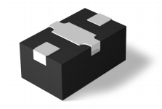
Si PIN DIODE SWITCH ELEMENT
Series, Shunt or Series-Shunt PIN Diodes
SMT Plastic Package
Medium Power Handling
Series PIN Diode Element
Series PIN Diode, Thermal-to-Ground Element
Shunt PIN Diode Element
Series-Shunt PIN Diode Element

Slide 53
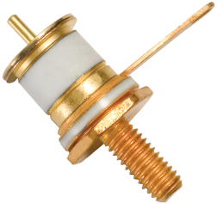

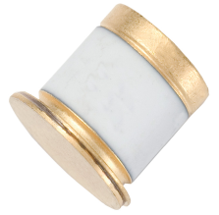
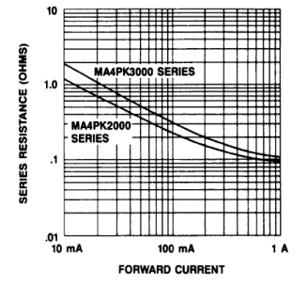
Discrete Kilovolt PIN Diodes
Features
High Voltage Handling:
Up to 2000 V, 3000 V
Power Handling: 1 kW
Operate from LF to 500 MHz
Long Carrier Lifetime: 30 µs, 65 µs
Very Low Thermal Resistance:
3 °C/W, 4 °C/W
Very Low Resistance: 0.1 Ω, 0.15 Ω
Applications
High Power and High Voltage Switching
Plasma Etching Systems
HF Radio Antenna Tuners

Slide 54
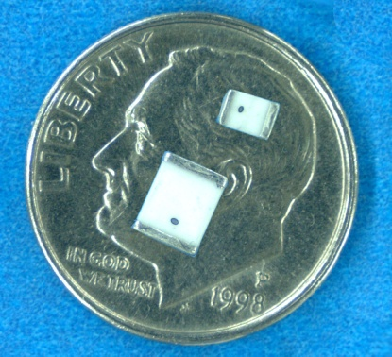
Discrete High Power MELF PIN Diodes
Features
High Voltage Handling: Up to 1100 V
200+ W Power Handling
Operate/Tunable from LF to 2.5 GHz
Surface Mountable
Non-Magnetic Versions
Superior Heat Management
Low Series Resistance
Applications
High Power Switches
Attenuators
Magnetic Resonance Imaging (MRI) Receiver Protection
#1 Supplier of MELF PIN Diodes
Available in Tape & Reel
Notes:
February 16, 2017

Slide 55
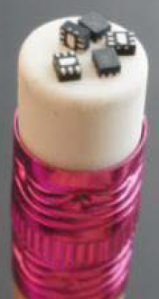
Discrete Limiter Products
Broadband Performance to 12 GHz and Higher
Several Packages Available Including
Low Inductance Shunt Configuration Plastic 1.5 X 1.2 mm DFN
Ceramic
Chips
Cascadable
Schottky-Limiter-PIN Shunt Antiparallel Pair
Shunt Limiter PIN
Limiter PIN

Slide 56
PIN Switches
Modules Single-Chip

Slide 57
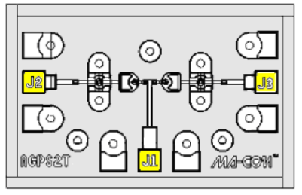
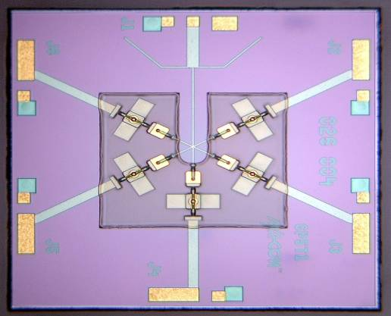
AlGaAs PIN Diode Switches
Product Offering
SPST to SP8T
Features
Operating Frequency = 50 MHz - 70 GHz
Maximum RF Average Incident Power = 0.25 W CW
AlGaAs ~ 0.3 dB Lower IL (20 GHz) vs. GaAs & Si Switches
Very Low Insertion Loss
Excellent Isolation
Low Switching Time
SP2T
SP5T
SPST

Slide 58
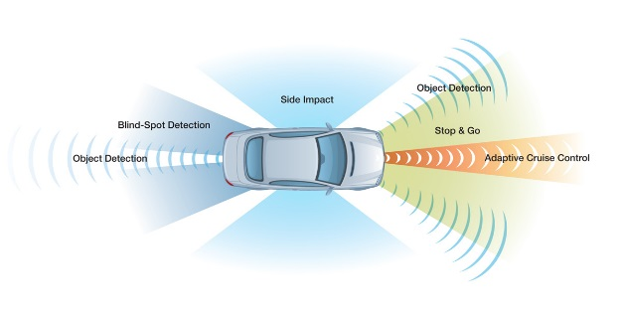
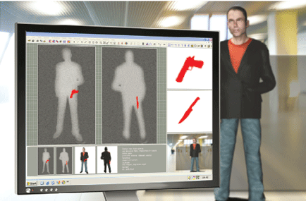
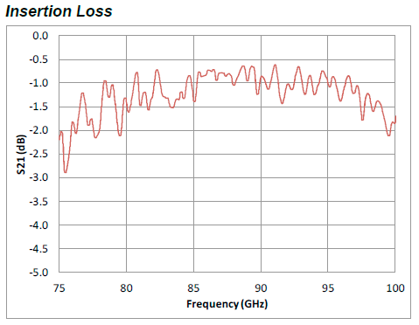
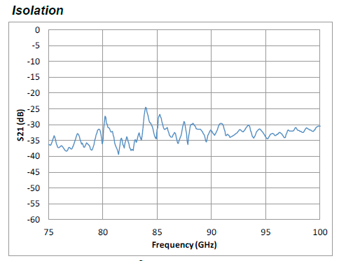
AlGaAs SP3T W Band Switch MASW-011029
Broadband Operating Frequency: 60 - 110 GHz
Insertion Loss:1.3 dB Typical
Isolation: 33 dB Typical
Silicon Nitride Passivation
BCB Scratch Protection
Collision Avoidance Radar
Passive Imaging

Slide 59

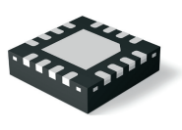
Multichip Module High Power Switches
Input power handling to 200 W CW, 1 kW peak
Frequency Range: 20 MHz – 6 GHz in three bands
Symmetric and Asymmetric Designs
SP2T, SP3T, SP4T, SP6T

Slide 60
T/R Switch-Limiter Module MSWLM2420-242
Features
Frequency Range: 2 – 4 GHz
T/R switch with passive receiver protection detector/limiter
Excellent Rx path insertion loss with 2 W CW receiver protector limiter stage
TX input power: 125 W CW, 200 W pk
Packaged in 5 x 8 mm, low-thermal-resistance surface-mount module package
Proven performance in the field
Applications
Phased array radar T/R modules
Radio transceiver

Slide 61
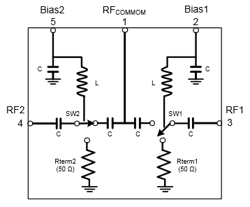
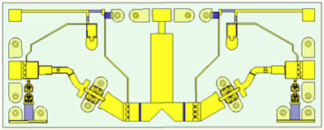
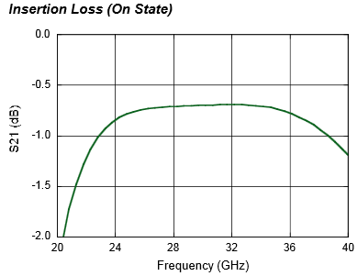
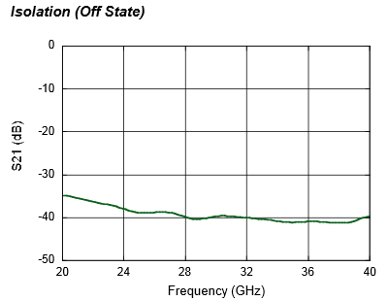
MASW-011036 Ka-Band High Power Terminated AlGaAs SPDT PIN Switch
Broadband Performance: 26 to 40 GHz
Low Loss <1 dB; High Isolation >38 dB
Up to 13 W CW Power, 85 °C
Die with G-S-G RF Pads and DC Bias Pads
Includes DC Blocks and RF Bias Networks
23 dBm power handling in terminated port
Notes:
Delete specs table?

Slide 62
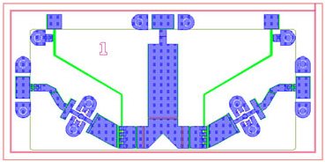
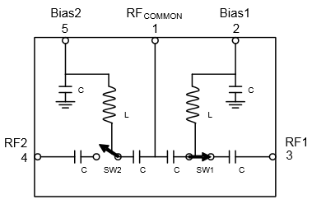
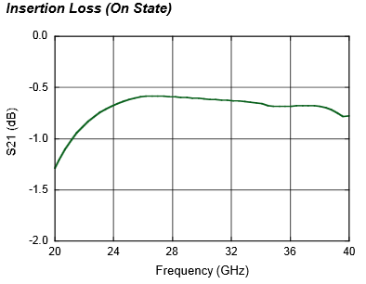
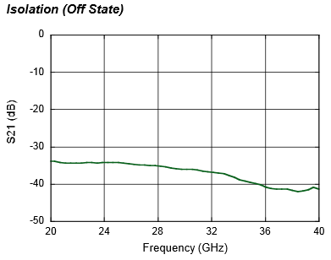
MASW-010646 Ka-Band High Power Reflective AlGaAs SPDT PIN Switch
Broadband Performance: 26 to 40 GHz
Low Loss: 0.6 dB
High Isolation: 32 dB
Up to 13 W CW Power, 85 °C
Die with G-S-G RF Pads and DC Bias Pads
Includes DC Blocks and RF Bias Networks
Notes:
Delete specs table?

Slide 63
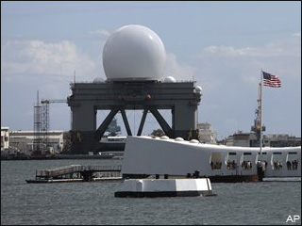
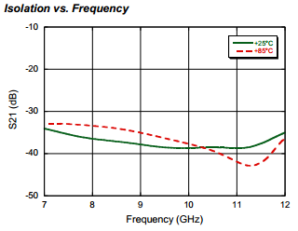
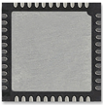
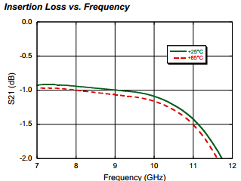
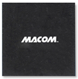
X-Band Terminated SPDT Switch MASW-011071
Low Insertion Loss: 1 dB
High Isolation: 38 dB
Integrated Bias Network and Termination Circuit
Greater than 20 W CW Power Handling @ 70 °C
Lead (Pb)-Free 7 x 7 mm 44-lead PQFN Package
Missile Defense, Weather Radar Systems

Slide 64
HMIC™ Si PIN Switches: 2 W, DC – 26 GHz
Products
MASW-001100-11900W (SPST)
MASW002100-11910W (SPDT)
MASW-003100-19220W (SP3T)
MASW-004100-11930W (SP4T)
MASW-005100-11940W (SP5T)
Features
Operating Frequency
50 MHz – 30 GHz
Series-Shunt Configuration
High Isolation: >35 dB
Low Loss: <1.0 dB Insertion Loss
Switching Time: 50 ns
Max RF Incident Power:
>6.0 W CW @ 2 GHz
2.0 W CW @ 22 GHz
RoHS Compliant
SP5T
SP3T w/ Integrated Bias Network
Notes:
64

Slide 65
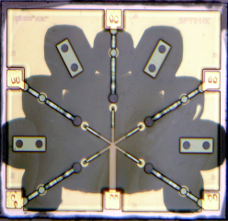
HMICTM Wire-Bondable Switches
Features
SPST through SP6T
Broadband Performance to 26 GHz
Wire /Ribbon Bond Connections
Available With or Without Integrated Bias Networks
SP3T with Bias Network
SP5T without Bias Network

Slide 66
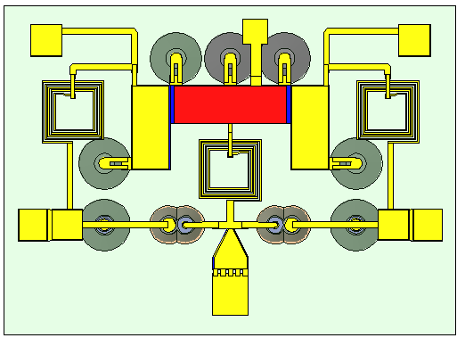
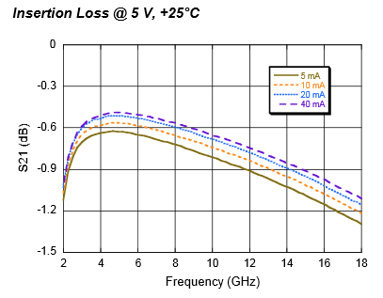
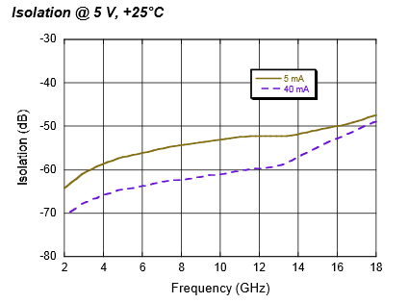
HMICTM SP2T High Current MASW-011052
Broad Bandwidth: Specified up to 18 GHz, Usable up to 26 GHz
Integrated Bias Network: High Bias Current +/- 60 mA
Low Insertion Loss/High Isolation
Glass Encapsulation Construction
RoHS Compliant and 260 °C Reflow Compatible

Slide 67
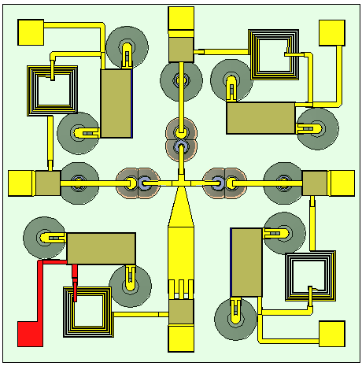
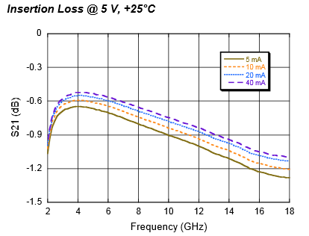
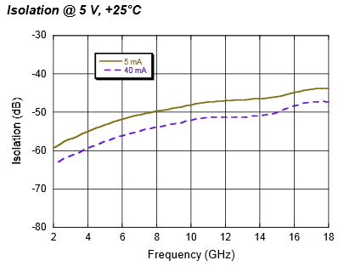
HMICTM SP3T High Current MASW-011053
Broad Bandwidth: Specified up to 18 GHz, Usable up to 26 GHz
Integrated Bias Network: High Bias Current +/- 60 mA
Low Insertion Loss/High Isolation
Glass Encapsulation Construction
RoHS Compliant and 260 °C Reflow Compatible

Slide 68
Limiter Modules

Slide 69
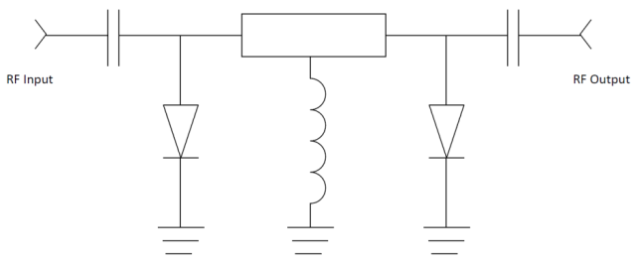

High Power Limiter Modules
Industry-leading input power handling as high as
300 W CW
2 kW peak
No external control signal or bias required
Available as
Single stage
Dual stage
Detector/limiter
Available in VHF, UHF, L, S and C bands
Packaged in low-thermal-resistance surface-mount hermetic or nonhermetic module packages

Slide 70
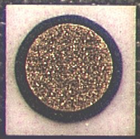
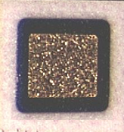
Discrete Diodes – Si PIN Chips
High Voltage Handling: up to 1000 V
Power Handling: 200+ Watts
Operate from LF to 18 GHz
Chip and Wire Assembly
Low Series Resistance
Applications: Switching and Attenuating
Part Number | Breakdown Voltage (V) | Capacitance (pF) | Series Resistance (Ω) | Carrier Lifetime (μs) | Thermal Resistance (ºC/W) | I-region (μm)
MADP-000165-01340W | 200 | 0.06 | 2.50 | 0.20 | 150 | 19
MA4P161-134 | 100 | 0.10 | 1.50 | 0.150 | 65 | 13
MA47416-132 | 200 | 0.15 | 6.00 | 2.00 | 30.0 | 110
MA47418-134 | 200 | 0.15 | 3.00 | 1.00 | 25.0 | 48
MA4P203-134 | 100 | 0.15 | 1.50 | 0.150 | 75.0 | 13
MA4P303-134 | 200 | 0.15 | 1.50 | 0.20 | 85 | 19
MA4P404-132 | 250 | 0.20 | 0.70 | 0.60 | 30.0 | 28
MA4P504-132 | 500 | 0.20 | 0.60 | 1.00 | 35.0 | 44
MA4P604-131 | 1000 | 0.30 | 1.00 | 3.00 | 10.0 | 96
MA4P505-131 | 500 | 0.35 | 0.45 | 2.00 | 14.0 | 96
MA4P606-131 | 1000 | 0.60 | 0.70 | 4.00 | 8.0 | 96
MA4P506-131 | 500 | 0.70 | 0.30 | 3.00 | 11.0 | 51
MA4P607-212 | 1000 | 1.30 | 0.40 | 5.00 | 4.0 | 125
Notes:
February 16, 2017

Slide 71
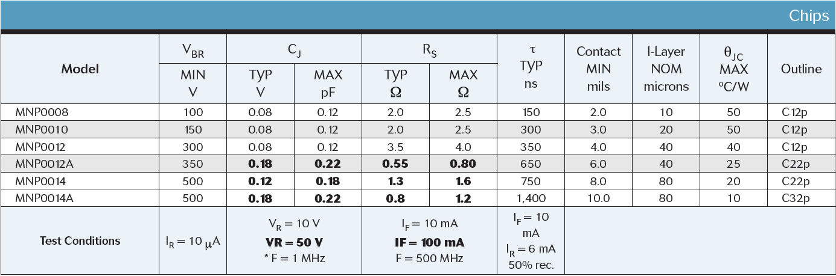
Discrete Diodes – Si NIP Chips
High Voltage Handling: up to 500 V
Power Handling: 50+ Watts
Operate from LF to 12+ GHz
Chip and Wire Assembly or Available in Packages
Low Series Resistance
Applications: Switching and Attenuating
Notes:
February 16, 2017

Slide 72
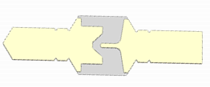
Si Mesa Beamlead PIN Diodes
Rugged Silicon-Glass Construction
Silicon Nitride Passivation
Low Parasitic Capacitance and Inductance

Slide 73
Si Planar Beamlead PIN Diodes
Rugged Silicon-Glass Construction
Silicon Nitride Passivation
Low Parasitic Capacitance and Inductance

Slide 74
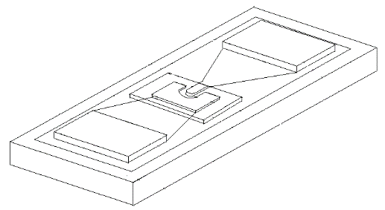
Flip Chip Products
Low Capacitance Devices
PIN Diodes | Configuration | Max Frequency | Breakdown Voltage Vb | Ct Max | Rs Typical | Material
 |  | (GHz) | (V) | (pf) | (Ω)
MA4GP907 | Single | 40 | 45 | 0.025 | 4.2 | GaAs
MA4AGP907 | Single | 50 | 50 | 0.020 | 4.2 | AlGaAs
MA4FCP200 | Single | 40 | 50 | 0.015 | 2.8 | HMIC
MA4FCP300 | Single | 30 | 70 | 0.025 | 2.6 | HMIC
MA4FCP305 | Single | 18 | 40 | 0.050 | 2.1 | HMIC
Varactor Diodes | Configuration | Max Frequency | Breakdown Voltage Vb | Ct 4V | Gamma | Material
 |  | (GHz) | (V) | (pf)
MA46H146 | Single | 60 | 26 | 0.033-0.06 | 1 | GaAs
MA46H120 | Single | 60 | 15 | 0.20-0.40 | 0.5 | GaAs

Slide 75
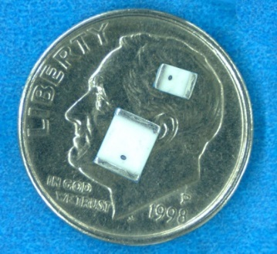
Discrete High Power MELF PIN Diodes
Part Number | Breakdown Voltage | Total Capacitance | Series Resistance | Carrier Lifetime | Thermal Resistance Θ
 | (V) | (pF) | (Ω) | (μs) | (ºC/W)
MA4P504-1072T | 500 | 0.5 | 0.6 | 1.0 | 15
MA4PH236-1072T | 200 | 0.5 | 3.00 | 1.5 | 25
MA4PH238-1072T | 200 | 0.5 | 6.00 | 2.0 | 25
MA4P404-1072T | 250 | 0.6 | 0.60 | 0.6 | 10
MA4P505-1072T | 500 | 0.7 | 0.45 | 2.0 | 6
MA4P7006F-1072T | 600 | 0.7 | 0.90 | 3.0 | 50
MA4P7417-1072T | 800 | 0.7 | 0.80 | 6.5 | 13
MA4P7104F-1072T | 400 | 1.0 | 0.50 | 2.5 | 50
MA4P506-1072T | 500 | 1.0 | 0.30 | 3.0 | 10
MA4P1250-1072T | 50 | 1.2 | 0.75 | 2.0 | 15
MA4PH235-1072T | 35 | 1.2 | 0.50 | 0.3 | 20
MADP-000234-10720T | 500 | 1.7 | 0.25 | 1.5 | 30
MA4P4301F-1091T | 100 | 2.0 | 1.00 | 8.0 | 30
MA4P4306F-1091T | 600 | 2.0 | 1.00 | 8.0 | 30
MA4P4006F-1091T | 600 | 2.2 | 0.50 | 6.0 | 20
MA4P1450-1091T | 50 | 2.5 | 0.75 | 2.0 | 5
MA4P7418-1072T | 1100 | 0.8 | 1.20 | 5.0 | 13
High Voltage Handling: Up to 1100 V
200+ W Power Handling
Operate/Tunable from DC to 2.5 GHz
Surface Mountable
Non-Magnetic Versions
Superior Heat Management
Low Series Resistance
Applications
High Power Switches
Attenuators
Magnetic Resonance Imaging (MRI)
Non Magnetic Package | MA4P7441F-1091T | 100 | 2.2 | 0.50 | 18 | 5
 | MA4P7446F-1091T | 600 | 2.2 | 0.50 | 18 | 6
 | MA4P7452F-1072T | 150 | 0.7 | 0.90 | 9 | 15
 | MA4P7461F-1072T | 100 | 1.0 | 0.50 | 6 | 15
 | MA4P7464F-1072T | 400 | 0.8 | 0.60 | 4.5 | 20
 | MA4P7470F-1072T | 800 | 0.7 | 0.80 | 6.5 | 13
 | MADP-000235-10720T | 35 | 1.2 | 0.50 | 0.3 | 20
Available in Tape & Reel
#1 Supplier of MELF PIN DIODES
Notes:
February 16, 2017

Slide 76
PIN DIODE SWITCH ELEMENT
Part Number | Rated Power Max (W) | Frequency Maximum (GHz) | Insertion Loss Typical |  |  | Isolation Typical |  |  | Package
 |  |  | Frequency (GHz) |  |  | Frequency (GHz)
 |  |  | 1 | 2.5 | 6 | 1 | 2.5 | 6
MSWSE-005-10S | 5 | 6 | 0.15 | 0.2 | 0.25 | 26 | 17 | 10 | 402
MSWSE-005-15 | 4 | 6 | 0.2 | 0.25 | 0.45 | 24 | 17 | 10 | 503
MSWSE-010-15 | 10 | 2.5 | 0.25 | 0.25 | – | 18 | 9 | – | 503
MSWSE-010-15S | 10 | 3 | 0.05 | 0.25 | – | 20 | 15 | – | 0402P
MSWSE-010-16S | 10 | 3 | 0.06 | 0.08 | – | 20 | 14 | – | 0402P
MSWSE-020-05 | 20 | 1 | 0.05 | – | – | 8 | – | – | 503
MADP-010630-13920T | 25 | 3 | 0.15 | 0.35 | - | 17 | 9 | - | 0805
MSWSE-020-10 | 20 | 1 | 0.03 | – | – | 18 | – | – | 503
MADP-010631-13920T | 40 | 1 | 0.05 | 0.08 | - | 7 | - | - | 0805
MSWSE-040-10 | 40 | 3 | 0.1 | 0.2 | – | 20 | 12 | – | 0805P
MSWSE-044-10 | 40 | 2 | 0.15 | 0.3 | – | 15 | 8 | – | 0805P
MSWSE-050-10 | 50 | 1 | 0.1 | – | – | 10 | – | – | 0805P
MADP-010633-13920T | >50 | 3 | 0.15 | 0.30 | - | 15 | 7 | - | 0805
MSWSE-050-17 | 40 | 3 | 0.06 | 0.1 | – | 18 | 11 | – | 0805P
MSWSER-070-10 | 80 | 0.8 | 0.06 | – | – | 10 | – | – | 3023
MSWSER-100-05 | 80 | 0.8 | 0.15 | – | – | 10 | – | – | 3023
Discrete Series PIN Diode
Plastic Package
Medium Power Handling
Part Number | Rated Power Max (W) | Frequency Maximum (GHz) | Insertion Loss Typical |  |  | Isolation Typical |  |  | Package*
 |  |  | Frequency (GHz) |  |  | Frequency (GHz)
 |  |  | 1 | 2.5 | 6 | 1 | 2.5 | 6
MEST2G-010-20 | 10 | 10 | 0.3 | 0.3 | 0.45 | 31 | 23 | 18 | 2012
MEST2G-020-15 | 20 | 6 | 0.2 | 0.22 | 0.3 | 25 | 20 | 11 | 2012
MEST2G-050-45 | 50 | 2.5 | 0.15 | 0.15 | – | 16 | 10 | – | 2615
MEST2G-050-80 | 50 | 1.5 | 0.15 | 0.2 | – | 14 | 8 | – | 2615
MEST2G-010-20 | 10 | 10 | 0.3 | 0.3 | 0.45 | 31 | 23 | 18 | 2012

Slide 77
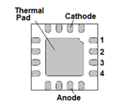


PIN DIODE SWITCH ELEMENT
Die mounted on thermally-conductive, electrically-insulating substrate
Very low thermal resistance for high-power handling
Part Number | Rated CW Power Max (W) | Frequency Maximum (GHz) | Insertion Loss Typical |  |  | Isolation Typical |  |  | Package*
 |  |  | Frequency (GHz) |  |  | Frequency (GHz)
 |  |  | 1 | 2.5 | 6 | 1 | 2.5 | 6
MEST2G-025-10 | 25 | 4 | 0.06 | 0.3 | - | 18 | 12 | - | CM32
MEST2G-080-25 | 80 | 10 | 0.2 | 0.25 | 0.45 | 30 | 24 | 17 | CM27
MEST2G-100-20-CM33 | 100 | 2.6 | 0.15 | 0.2 | – | 16.5 | 10 | – | CM33
MEST2G-150-10-CM30 | 15W | 1 | 0.07 | - | - | 6 | - | - | CM30
MEST2G-150-10-CM32 | 150 | 2 | 0.12 | 0.16 | - | 12 | 6 | - | CM32
MEST2G-160-10-CM33 | 160 | 2.8 | 0.06 | 0.6 | - | 28 | 20 | - | CM33
MADP-011037 | >125 | 3 | 0.1 | 0.3 | - | 16 | 8 |  | 3mm QFN
CMxx Packages:
QFN Package:

Slide 78

Shunt PIN Element
Plastic Over-Mold Package
Very Low Inductance Package for High Isolation
Part Number | Rated Power Max (W) | Frequency Maximum (GHz) | Insertion Loss Typical |  |  | Isolation Typical |  |  | Package
 |  |  | Frequency (GHz) |  |  | Frequency (GHz)
 |  |  | 1 | 2.5 | 6 | 1 | 2.5 | 6
MSWSH-020-24 | 25 | 26 | 0.05 | 0.2 | 0.3 | 28 | 27 | 26 | 2020
MSWSH-020-30 | 20 | 6 | 0.05 | 0.15 | 0.35 | 35 | 31 | 26 | 2012
MSHSH-040-30 | 40 | 6 | 0.04 | 0.1 | 0.3 | 35 | 32 | 36 | 2012
MSWSHC-040-40 | 40 | 10 | 0.1 | 0.2 | 0.4 | 35 | 55 | 50 | 2615
MSWSHB-020-30 | 40 | 10 | 0.02 | 0.08 | 0.13 | 40 | 40 | 35 | 2012

Slide 79
HMICTM Discrete Diode Solution
Surmount PIN diodes
Available I-region Thickness: 7 to 100 µm
Part Number | Size (mils) | VB (V) | 1 MHz | 100 MHz |  |  | 1 GHz |  |  |  |  | Lifetime (ns) | Nominal I-region (μm)
 |  |  | Cj 40 V (pF) | Rs 10 mA (Ω) | Rs 20 mA (Ω) | Rs 100 mA (Ω) | Cj 40 V (pF) | Rs 10 mA (Ω) | Rs 20 mA (Ω) | Rs 50 mA (Ω) | Rs 70 mA (Ω)
MADP-042305 | 22 X 41 | 80 | 0.13 |  |  |  | 0.14 |  | 1.32 | 1.18 |  | 180 | 7
MADP-042405 | 22 X 41 | 80 | 0.57 |  |  |  | 0.58 |  | 0.62 | 0.58 |  | 255 | 7
MADP-042505 | 22 X 41 | 80 | 0.27 |  |  |  | 0.27 |  | 0.83 | 0.76 |  | 210 | 7
MADP-042905 | 22 X 41 | 80 | 0.06 |  |  |  | 0.06 |  | 3.14 | 2.6 |  | 140 | 7
MA4SPS302 | 23 X 55 | 70 | 0.40 | 1 |  |  | 0.30 | 1.3 |  |  |  | 460 | 10
MA4SPS402 | 20 X 49 | 70 | 0.034 | 4.6 |  |  | 0.04 | 5 |  |  |  | 200 | 10
MADP-017015-1314 | 60 X 30 | 115 | 0.32 |  |  |  | 0.31 | 0.72 |  |  | 0.51 | 1300 | 15
MADP-030015-1314 | 60 X 30 | 115 | 0.79 |  |  |  | 0.78 | 0.49 |  |  | 0.38 | 1600 | 15
MADP-017025-1314 | 60 X 30 | 135 | 0.23 |  |  |  | 0.23 | 1.01 |  |  | 0.64 | 2300 | 25
MADP-030025-1314 | 60 X 30 | 135 | 0.50 |  |  |  | 0.50 | 0.65 |  |  | 0.45 | 2800 | 25
MA4SPS502 | 23 X 57 | 200 | 0.14 |  | 2.4 | 1.4 | 0.09 |  |  |  |  | 2800 | 50
MA4SPS552 | 12 X 22 | 200 | 0.08 |  | 2.4 | 1.7 | 0.06 |  |  |  |  | 2500 | 50
MA4SPS421 | 20 X 41 | 200 | 0.09 |  |  |  | 0.07 | 6.2 |  |  |  | 5000 | 100
MA4SPS422 | 20 X 41 | 200 | 0.18 |  |  |  | 0.13 | 3.1 |  |  |  | 10000 | 100
MADP-042308-1306 | 20 X 41 | 100 | 0.20 |  |  |  | 0.10 |  | 1.38 | 1.18 |  | 280 | 10
MADP-042408-1306 | 20 X 41 | 100 | 0.50 |  |  |  | 0.37 |  | 0.67 | 0.61 |  | 380 | 10
MADP-042508-1306 | 20 X 41 | 100 | 0.30 |  |  |  | 0.18 |  | 0.97 | 0.87 |  | 310 | 10
MADP-042908-1306 | 20 X 41 | 100 | 0.15 |  |  |  | 0.05 |  | 3.63 | 3.02 |  | 230 | 10

Slide 80
Discrete Diodes – Limiters
Die Versions (to 20 GHz)
Available in Ceramic & Plastic Packages (up to 12 GHz)
Low Capacitance
Cascadable for Increased Power Handling and Limiting
Au-doped and non-Au-doped diodes available to optimize recovery time and flat leakage power
Part Number | Min V_{B} | Max V_{B} | Min C_{j} @ 0 V | Max C_{j} @ 0 V | Max Rs @ 10 mA | Nominal Characteristics
 |  |  |  |  |  | Carrier Lifetime | Intrinsic Region Thickness | Contact Diameter | Thermal Resistance
 | V | V | pF | pF | Ω | ns | μm | mils | ºC/W
MA4L011-134 | 15 | 35 | 0.08 | 0.18 | 2.10 | 10 | 2 | 1.2 | 175
MA4L021-134 | 20 | 35 | 0.10 | 0.20 | 2.10 | 10 | 2 | 1.2 | 175
MA4L022-134 | 20 | 35 | 0.09 | 0.19 | 2.00 | 10 | 2 | 1.2 | 175
MADL-011009-0134 | 20 | 35 | 0.16 | 0.23 | 1.50 | 10 | 2 | 3.0 | 175
MA4L031-134 | 30 | 50 | 0.14 | 0.21 | 2.00 | 20 | 3 | 1.4 | 150
MA4L032-134 | 30 | 50 | 0.13 | 0.20 | 2.50 | 15 | 3 | 1.5 | 150
MADL-011010-0134 | 30 | 50 | 0.17 | 0.24 | 1.50 | 15 | 3 | 3.0 | 150
MA4L062-134 | 60 | 75 | 0.07 | 0.15 | 2.50 | 10 | 4 | 1.5 | 150
MADL-011011-0134 | 60 | 75 | 0.05 | 0.17 | 2.30 | 10 | 4 | 3.0 | 150
MA4L101-134 | 100 |  |  | 0.15 | 2.00 | 90 | 13 | 3.5 | 30
MADL-000301-0134 | 200 |  |  | 0.20 | 1.50 | 200 | 20 | 3.0 | 30
MA4L401-134 | 250 |  |  | 0.30 | 1.20 | 800 | 25 | 4.5 | 25

Slide 81
HMIC and AlGaAs MMIC Performance Comparison
Parameter | HMIC | AlGaAs
Products | Switches, Attenuators, Limiters | Switches
Medium | Silicon and Glass | Semi-Insulating GaAs
Die Thickness (um) | 125 | 100
Intrinsic Length (um) | 8 to 100 | 3
I/O Connections | Wire Bondable and SMT | Wire Bondable Only
Passive R,L,C Integration | Yes | Yes
Breakdown Voltage (V) | 50 to 200 | 70
F (GHz) | 0.050 - 30 | 0.050 - 70
Insertion Loss at 10 GHz (SP4T) | 0.6 | 0.45
Switching Speed (ns) | 100 | 15
IIP3 (dBm) | 45 | 25
CW Power Handling, @ 2 GHz (dBm) | +38 | +23

Slide 82
AlGaAs Products
Topology | Frequency (GHz) | Insertion Loss (dB) | Isolation (dB) | P_{1dB} (dBm) | Reflective or Absorptive | Bias (mA) | Part Number | Package
SPST | 0.05 - 18 18 – 50 | 0.2 0.3 | 22 46 | 23 | Reflective | 10 | MA4AGSW1 | DIE
SPST | 10-50 | 1.2 | 30 | 23 | Absorptive | 10 | MA4AGSW1A | DIE
SP2T | 0.05 - 18 18 – 50 | 0.5 0.7 | 47 33 | 23 | Reflective | 10 | MA4AGSW2 | DIE
SP3T | 0.05 - 18 18 – 50 | 0.6 0.8 | 45 31 | 23 | Reflective | 10 | MA4AGSW3 | DIE
SP4T | 0.05 - 18 18 – 50 | 0.7 1.0 | 41 32 | 23 | Reflective | 10 | MA4AGSW4 | DIE
SP5T | 0.05 - 18 18 – 50 | 1.4 1.9 | 35 30 | 23 | Reflective | 10 | MA4AGSW5 | DIE
SP8T | 0.05 - 18 18 - 50 | 1.5 2.0 | 32 32 | 23 | Reflective | 10 | MA4AGSW8-1 | DIE

Slide 83

MASW-011036 Ka-Band High Power Terminated AlGaAs SPDT PIN Switch
Broadband Performance: 26 to 40 GHz
Low Loss <1 dB; High Isolation >38 dB
Up to 13 W CW Power, 85 °C
Die with G-S-G RF Pads and DC Bias Pads
Includes DC Blocks and RF Bias Networks
23 dBm power handling in terminated port
Notes:
Delete specs table?

Slide 84

MASW-010646 Ka-Band High Power Reflective AlGaAs SPDT PIN Switch
Broadband Performance: 26 to 40 GHz
Low Loss: 0.6 dB
High Isolation: 32 dB
Up to 13 W CW Power, 85 °C
Die with G-S-G RF Pads and DC Bias Pads
Includes DC Blocks and RF Bias Networks
Notes:
Delete specs table?

Slide 85




HMICTM SP2T 6-14 GHz (Terminated SPDT) MASW-010647
X-Band Terminated SPDT switch
Wire-Bondable Bare Die
Low Insertion Loss/ High Isolation
All Shunt Design; Integrated Bias Network
Glass Encapsulated Construction
Greater than 20 W CW Power Handling @ 85 °C
Silicon Nitride Passivation/Polymer Scratch Protection
RoHS Compliant
Notes:
Delete specs table?

Slide 86






HMICTM Package-less Surface Mountable Si PIN Diode Switches
Surface mount - No wirebonds
Packageless - Low parasitics
Series/Shunt multi-throw designs
High Power - 6 W incident
Topology | Frequency | Insertion Loss (dB) | Isolation (dB) | P_{0.1dB} (dBm) | Part Number
SPDT | 6 GHz 13 GHz 20 GHz | 0.6 0.9 1.2 | 45 31 25 | 36 | MASW-002103-1363
SP3T | 6 GHz 13 GHz 20 GHz | 0.65 0.95 1.25 | 37 28 22 | 36 | MASW-003103-1364
SP4T | 6 GHz 13 GHz 20 GHz | 0.7 1.0 1.3 | 35 30 26 | 36 | MASW-004103-1365

Slide 87




HMIC™ Si PIN SP2T 6-14 GHz MASW-011021
Specified from 8 GHz to 12 GHz ; Usable 6-14 GHz
Low Insertion Loss / High Isolation
All Shunt Design; Integrated Bias Network
Surface Mountable, Fully Monolithic Die
Glass Encapsulated Construction
20 W Pulsed Power Handling
Silicon Nitride Passivation / Polymer Scratch Protection
RoHS Compliant
Notes:
Delete Specs Table?

